Slide 1
Lesson objective
Test NEXT Tuesday.
Title: That’s fast!
Aim:
Calculate speed, distance and time periods using rates.
Plan:
Review simplifying ratios
Need for speed

Slide 2
I do
THINK: what number goes into both numbers?
Simplify
10 : 5
32 : 8
14 : 7

Slide 3
We do
THINK: what number goes into both numbers?
Simplify
15 : 5
9 : 3
18 : 2

Slide 4
You do – exercise books
THINK: what number goes into both numbers?
Simplify
12 : 6
4 : 12
9 : 3
25: 15

Slide 5
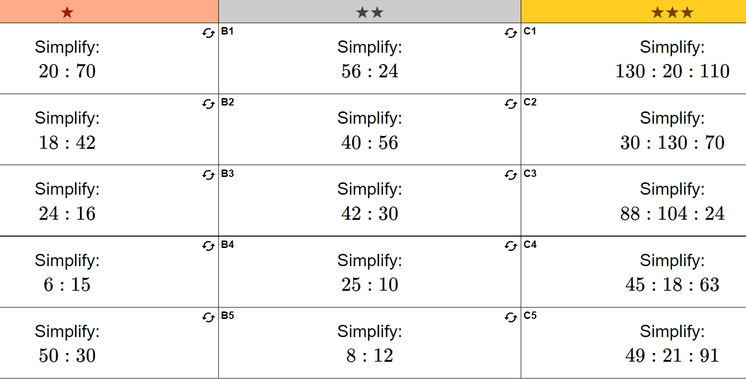

Slide 6
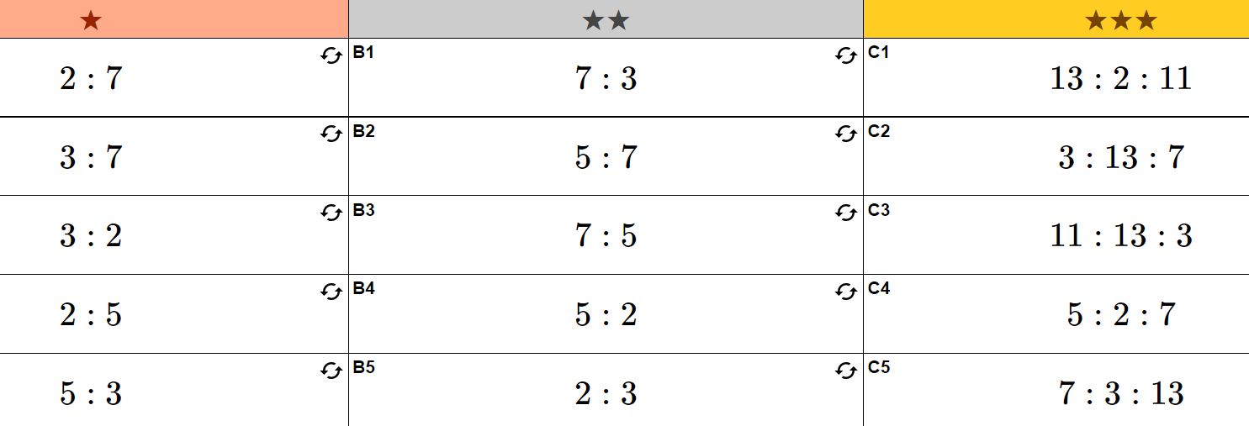

Slide 7
Fastest rapper in the world
https://www.youtube.com/watch?v=wUo1_8hXXBU
https://www.youtube.com/watch?v=i3CYGLURsf0

Slide 8
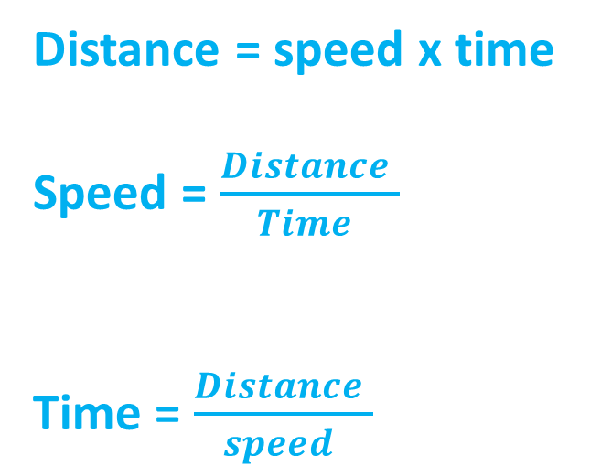
Speed, distance and time
Distance = speed x time
Speed = $\frac{Distance }{Time }$
Time = $\frac{Distance }{speed }$
DISTANCE
SPEED
TIME

Slide 9
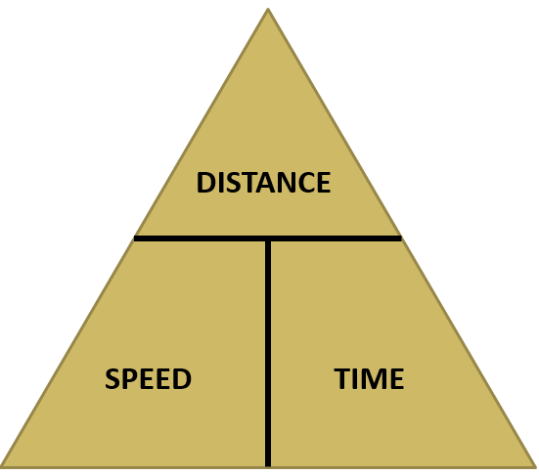
That’s fast
Go-karts race at a speed of 100km/h. How many kilometers can a go-kart travel in a 3-hour race?
A hot-air balloon took 3 hours to cover 24km. What was its
average speed?

Slide 10
Individual practice
Complete “that’s fast” question set.

